Slide 1
CO2412
Computational Thinking
Review of module parts 1 to 3
End-of-year reflection
Tutorial 2.3 discussion

Slide 2
Review of module
parts 1 to 3

Slide 3
Module structure
Upon successful completion of this module, a student will be able to:
  Use methods including logic and probability to reason about algorithms and data structures;
  Compare, select, and justify algorithms and data structures for a given problem;
  Analyse the computational complexity of problems and the efficiency of algorithms;
  Use a range of notations to represent and analyse problems;
  Implement and test algorithms and data structures.
program analysis
randomness and probability
algorithm design
complexity
graphs and trees
formal languages
logic

Slide 4
Part 1: Program analysis
On the topic of program analysis, we have:
  Considered the space (memory) and time efficiency of algorithms;
  Described asymptotic scaling behaviour using Landau O(n) notation;
  Analysed algorithms formally via pre-/postconditions of statements.

Slide 5
Part 1: Program analysis
On the topic of program analysis, we have:
  Considered the space (memory) and time efficiency of algorithms;
  Described asymptotic scaling behaviour using Landau O(n) notation;
  Analysed algorithms formally via pre-/postconditions of statements.
common efficiency classes:
iteration vs. recursion
constant, O(1)
program flow graphs
linear, O(n)
time & space efficiency
O(n log n)
Landau (“big O”) notation
quadratic, O(n²)

Slide 6
Part 2: Algorithm design
On the topic of algorithm design, we have:
  Compared and applied algorithm design strategies such as recursion, divide-and-conquer, greedy algorithms, dynamic programming;
  Looked at common data structures and their specification and implementation;
  Applied algorithm design to sorting as a highly relevant use case.

Slide 7
Part 2: Algorithm design
On the topic of algorithm design, we have:
  Compared and applied algorithm design strategies such as recursion, divide-and-conquer, greedy algorithms, dynamic programming;
  Looked at common data structures and their specification and implementation;
  Applied algorithm design to sorting as a highly relevant use case.
algorithm design strategies:
sequential data structures:
brute-force algorithms
(static) array
greedy algorithms
dynamic array
divide and conquer
singly linked list
dynamic programming
doubly linked list

Slide 8
Sorting algorithms: Selection sort
Selection sort: Greedy algorithm
Sorting algorithm that keeps selecting the smallest remaining element:
Test list: [35, 16, 58, 3, 11, 106, 15, 55, 7, 81, 1]
Step 1: [1] → Step 2: [1, 3] → Step 3: [1, 3, 7] → Step 4: [1, 3, 7, 11]
→ Step 5: [1, 3, 7, 11, 15] → Step 6: [1, 3, 7, 11, 15, 16] → …
→ Step 11: [1, 3, 7, 11, 15, 16, 35, 55, 58, 81, 106]

Slide 9
Sorting algorithms: Insertion sort
Insertion sort: Greedy algorithm
Sorting algorithm that keeps inserting the next element into a sorted list:
Test list: [35, 16, 58, 3, 11, 106, 15, 55, 7, 81, 1]
Step 1: [35] → Step 2: [16, 35] → Step 3: [16, 35, 58] → Step 4: [3, 16, 35, 58]
→ Step 5: [3, 11, 16, 35, 58] → Step 6: [3, 11, 16, 35, 58, 106] → …
→ Step 11: [1, 3, 7, 11, 15, 16, 35, 55, 58, 81, 106]

Slide 10
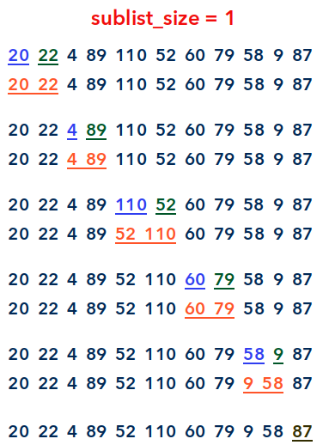
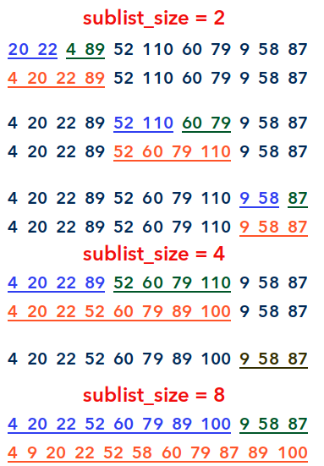
Sorting algorithms: Mergesort
Mergesort: Divide-and-conquer algorithm

Slide 11
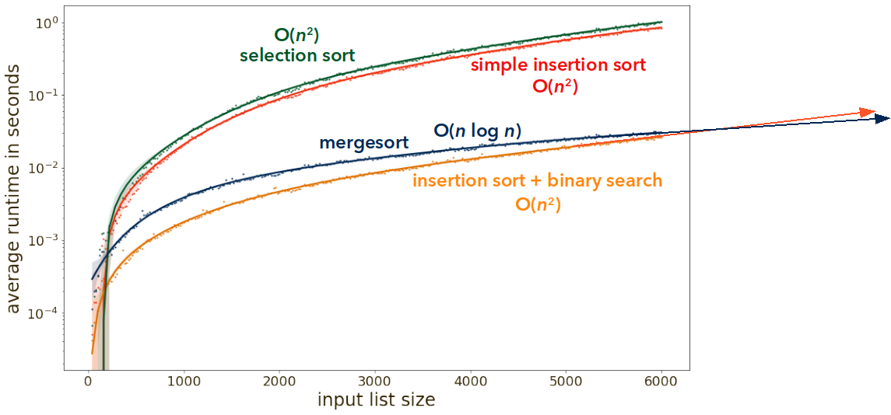
Sorting algorithms: Performance

Slide 12
Part 2: Algorithm design
Revising the concepts
What is the difference between dynamic programming and divide-and conquer?
12
[]
16
4
1
9
3
[9]
9, 16
8
[4]
11
[1]
4, 9, 16
16
1
4
4
1
1
9
2
4
[4, 4]
[4, 1]
[1, 1]
[9, 1]
4
7
10
[9, 1]

Slide 13
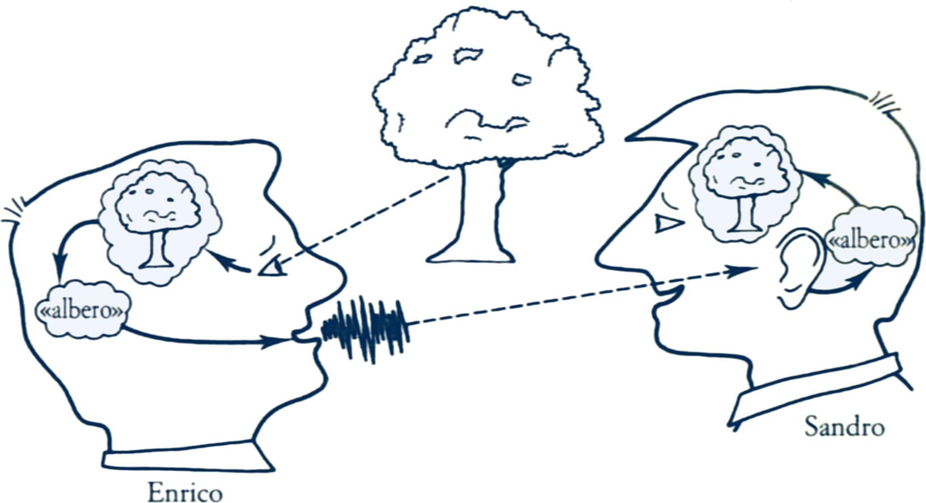
Part 3: Graphs and trees
On the topic of graphs and trees, we have:
  Introduced graph theory and its basic definitions and concepts, including trees as a special case;
  Addressed basic tasks/problems when dealing with graphs, e.g., computing shortest paths, strategies for graph traversal, and the application of trees to sorting and searching;
  Discussed numerical representations of graphs as data structures.
Fig. from R. Jackendoff, Patterns in the Mind (Italian translation).

Slide 14
Part 3: Graphs and trees
On the topic of graphs and trees, we have:
  Introduced graph theory and its basic definitions and concepts, including trees as a special case;
  Addressed basic tasks/problems when dealing with graphs, e.g., computing shortest paths, strategies for graph traversal, and the application of trees to sorting and searching;
  Discussed numerical representations of graphs as data structures.
binary search
graph
adjacency list
binary search tree
traversal
incidence list
balanced tree
spanning tree
adjacency matrix

Slide 15
Part 3: Graphs and trees
Trees as a special kind of graph, and graphs as a generalization of trees
tree (a kind of graph)
graph
unique path to node
cycle
cycle
unique root
diamond
Definition (“tree”; in the literature, also: “out-tree” or “rooted tree”)
A tree is a graph with a root and a unique path from the root to each node.

Slide 16
Graphs as data structures: Implementation
Neighbour lists, implemented as adjacency or incidence lists, are most suita-
ble for sparse graphs. Matrix-like data structures are best for dense graphs.
dense graphs
sparse graphs
comparably few edges
comparably many edges

Slide 17
Graphs as data structures: Implementation
Remark: This construction is particularly suitable for tree data structures, since trees are sparse graphs (in-degree ≤ 1), and they normally contain data items.
vertex
label
next
4
0
empty list
5
3
1
adjacency list
empty list
2
(list of vertices to which there is an edge)
2
6
7
0
1
3
8
9
list with pointers (or object references) to vertex 4 and vertex 5

Slide 18
Graphs as data structures: Implementation
For adjacency lists or incidence lists, a variety of data structures can be used, e.g., dynamic arrays. They need not be sequential data structures.
vertex
label
out
edge
4
3
a
a
label
5
b
3
target
a
incidence list
a
a
2
b
6
7
d
0
(list of edges to which the vertex is incident)
a
a
edge
c
1
a
b
label
8
9
vertex 4
target
vertex 5

Slide 19
Graphs as data structures: Implementation
Matrix-like data structures in Python include lists of lists (i.e., 2D dynamic arrays), if the numpy library is used, two-dimensional static arrays. For graphs, the most relevant data structure of this type is the adjacency matrix.
2
edge from 2 to 1
adj = [ [0, 1, 1, 0, 0],
[0, 0, 0, 1, 0],
[1, 1, 0, 0, 0],
[0, 1, 1, 0, 0],
[1, 0, 1, 0, 0] ]
1
3
no edge from 3 to 4
4
0
adj[2][1] = 1, or True
adj[3][4] = 0, or False

Slide 20
Graphs as data structures: Implementation
Matrix-like data structures in Python include lists of lists (i.e., 2D dynamic arrays), if the numpy library is used, two-dimensional static arrays. For graphs, the most relevant data structure of this type is the adjacency matrix.
2
adj = [ [0, 1, 1, 0, 0],
[0, 0, 0, 1, 0],
[1, 1, 0, 0, 0],
[0, 1, 1, 0, 0],
[1, 0, 1, 0, 0] ]
out of node 0
1
out of node 1
3
out of node 2
out of node 3
4
0
For a sparse graph, the vast majority of entries in the 2D array/matrix is zero. Adjacency matrices are commonly only used when expecting a dense graph.

Slide 21
Part 3: Graphs and trees
Revising the concepts
We define a tree to be a graph with:
  one unique root node;
  one unique path from the root node to each node.
Assume that in a graph there is a node with two incoming edges.
Why is it impossible that such a graph is a tree?
B
C
A

Slide 22
End-of-year reflection

Slide 23
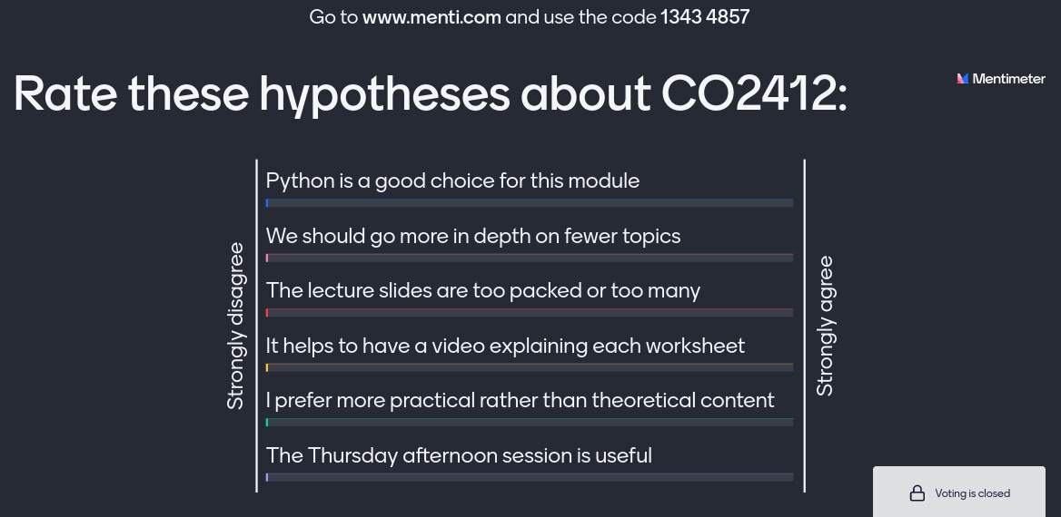
Help improve the module for the coming year
https://www.menti.com/ with code 1343 4857

Slide 24
Tutorial 2.3 discussion

Slide 25
Problem 2.3.1: Performance of doubly linked lists
A list with n elements is given.
Iterate over the whole list, and for each element:
  If it is a multiple of 3, delete it from the list;
  If it has a remainder of 1 upon division by three, do nothing;
  If it has a remainder of 2, insert a copy of the element right next to it.
In this way, e.g., [19, 12, 20, 12, 4] is modified to become [19, 20, 20, 4].

Slide 26
Problem 2.3.1: Performance of doubly linked lists
In a singly linked list, each node contains a data item and a reference (or pointer) to the next node. This facilitates traversal in one direction, namely forward, and inserting a new data item after any given node, in constant time.
Singly linked lists require two variables per data item (item and next).
item
next
1
item
next
None
12
item
next
head
tail
7

Slide 27
Problem 2.3.1: Performance of doubly linked lists
In a doubly linked list, each node additionally contains a reference to the previous node. This facilitates traversal in both directions and inserting a new data item before any given node (rather than only after it), all in constant time.
Singly linked lists require two variables per data item (item and next).
Doubly linked lists require three variables per data item (prev, item, and next).
prev
item
next
1
prev
item
next
None
None
12
prev
item
next
head
tail
7

Slide 28
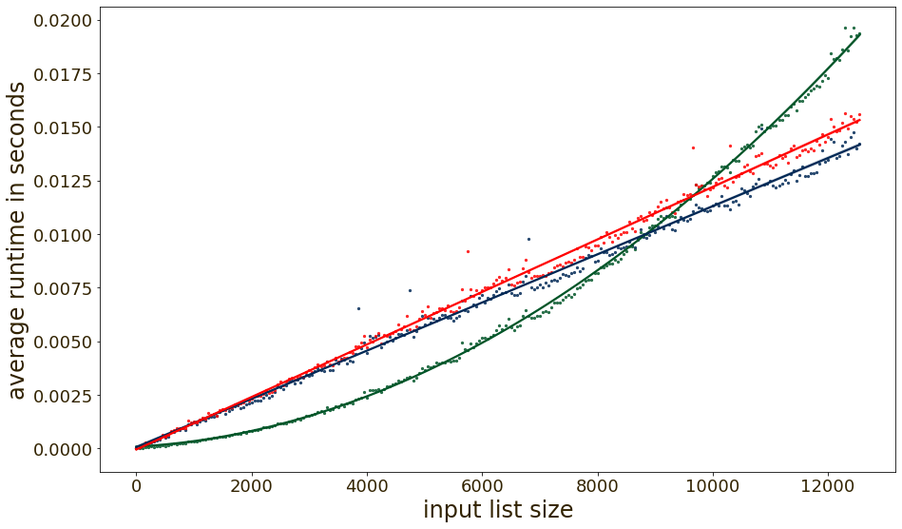
Problem 2.3.1: Performance of doubly linked lists
For technical implementation details, and the performance measurement, see the linked-list-performance Jupyter Notebook.
doubly linked list
singly linked list
Python list

Slide 29
Problem 2.3.2: Dantzig’s algorithm
Greedy algorithm for the knapsack problem:
  There is a limited capacity c.
  Loadable items each have a weight w[i] and a value v[i].
  Dantzig’s algorithm selects them in descending order of v[i] / w[i].
  The algorithm terminates when no more items fit into the capacity.
The question was: Does this algorithm always determine the best solution?
capacity 8
value 20
value 12
value 12
value 3
weight 5
weight 4
weight 4
weight 3

Slide 30
Problem 2.3.2: Dantzig’s algorithm
Greedy algorithm for the knapsack problem:
  There is a limited capacity c.
  Loadable items each have a weight w[i] and a value v[i].
  Dantzig’s algorithm selects them in descending order of v[i] / w[i].
  The algorithm terminates when no more items fit into the capacity.
The question was: Does this algorithm always determine the best solution?
total cargo
value: 23
value 20
value 3
capacity 8
20/5 = 4
12/4 = 3
12/4 = 3
3/3 = 1
value 20
value 12
value 12
value 3
weight 5
weight 4
weight 4
weight 3

Slide 31
Problem 2.3.2: Dantzig’s algorithm
Greedy algorithm for the knapsack problem:
  There is a limited capacity c.
  Loadable items each have a weight w[i] and a value v[i].
  Dantzig’s algorithm selects them in descending order of v[i] / w[i].
  The algorithm terminates when no more items fit into the capacity.
The question was: Does this algorithm always determine the best solution?
total cargo
value: 23
value 20
value 3
capacity 8
Optimal solution, not found by Dantzig’s algorithm:
total cargo
value: 24
value 12
value 12
capacity 8

Slide 32
CO2412
Computational Thinking
Review of module parts 1 to 3
End-of-year reflection
Tutorial 2.3 discussion

